Slide 1
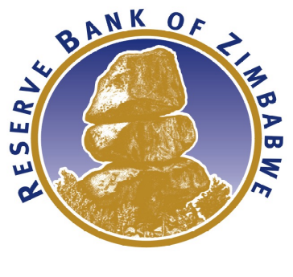
MONETARY POLICY COMPLEMENTING FISCAL POLICY IN CONSOLIDATING ECONOMIC TRANSFORMATION TOWARD VISION 2030:IMPLICATIONS ON THE 2024 NATIONAL BUDGET
PRESENTATION AT THE PRE-BUDGET PARLIAMENTARY SEMINAR
BY
DR. JOHN P. MANGUDYA
GOVERNOR
1 NOVEMBER 2023

Slide 2
STATE OF MONETARY AND FINANCIAL CONDITIONS
Monetary and financial conditions have remained tight to anchor inflation and exchange rate expectations. These conditions are characterized by:
  Interest rate policy aligned to inflation developments;
  A liberalised foreign exchange market;
  High statutory reserve requirements to manage bank lending and curb speculative borrowing;
  Deposit interest rates aligned to inflation developments; and
  Value preservative instruments to ensure certainty and predictability of investable funds.
The monetary stance has been complemented by a tight fiscal stance and these have combined to entrench the obtaining price and exchange rate stability.
The 2024 National budget should complement the current fiscal and monetary stance in addressing emerging global and domestic risks from growth slowdown, geopolitical factors and climatic shocks.

Slide 3
GLOBAL MONETARY AND FINANCIAL CONDITIONS
Inflation Development in UK, EU and USA (%)
Trend of Policy Rate Hikes UK, EU and USA (%)
Global economies have been experiencing rising inflation since 2021 due to supply chain disruptions (COVID restrictions, geo-political tensions). In 2022 global inflation average 8.7%.
US Inflation rose from 1.4% in January 2021 to a peak of 9.1% in June 2022. Inflation in the UK increased from 0.9% in January 2021 to a peak of 9.6% in October 2022.
Global inflationary pressures to remain elevated with global inflation expected at 6.9% in 2023 and 5.8% in 2024 supported by tighter monetary conditions.
In response to rising inflation, central banks aggressively tightened monetary policy.
Policy rates have risen from near 0% in 2021 to over 4.0% in 2023.
As a result, borrowing costs have increased significantly with the key reference rate Secured Overnight Financing Rate (SOFR) increasing from 0.05% in January 2022 to 5.31% in October 2023.

Slide 4
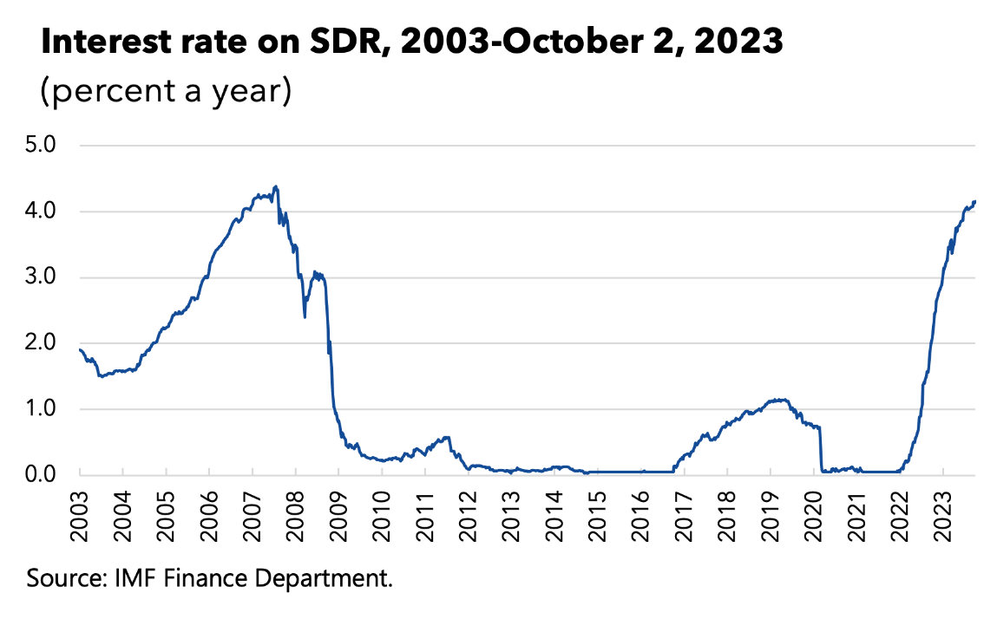
IMPLICATIONS OF TIGHT GLOBAL FINANCIAL CONDITIONS
The tight global monetary and financial conditions have resulted in:
  Low aggregate demand and slowing growth.
  Credit squeeze resulting in higher interest rates i.e., the interest rate on Special Drawing Rights (SDR) increased from 0.05% in August 2021 to 4.198% in October 2023, putting budgetary pressures on countries that have utilised their SDR allocations, including Zimbabwe.
  Reduced capital flows to emerging and developing countries.
  Low commodity prices with implications on export earnings.
  Pressure on the exchange rates of most emerging and developing economies.
Strong coordination of monetary and fiscal policy is, therefore, critical to contain these emerging risks and safeguard current stability.

Slide 5
INTERNATIONAL COMMODITY PRICE DEVELOPMENTS
Prices of Platinum Group Metals Sep 2021 to Oct 2023 US$/ Ounce
Price of Lithium Feb 2023 to Oct 2023 US$/tonne
Price of Nickel Aug 2022 to Oct 2023 US$/tonne

Slide 6
DOMESTIC FOREIGN CURRENCY INFLOWS AT A GLANCE
Type of Receipt | Jan - Sept | % Contr | Jan -Sept | % Contr | % Change
 | 2023 |  | 2022
Export Proceeds | 4,748.80 | 56% | 5,251.0 | 63% | -9.6%
International Remittances Of which Diaspora Remittances | 1,321.88 | 16% | 1,219.0 | 15% | 8%
NGOs | 874.48 | 10% | 860.7 | 10% | 2%
Loan Proceeds (Private) | 1,235.40 | 15% | 703.2 | 8% | 75.7%
Income receipts | 92.16 | 1.1% | 116.3 | 1% | -21%
Foreign Investment | 215.56 | 2.5% | 131.6 | 1.6% | 64%
TOTAL | 8,488.29 | 100% | 8,281.9 | 100% | 2.5%
Export receipts were down by 9.6% from US$ 5.25 billion recorded Jan-Sep 2022 to US$ 4.75 billion for the same period in 2023.
Foreign currency receipts for the period January 2023 to September 2023 grew by 2.5% supported by significant inflows of diaspora remittances (US$ 1.32 billion) and private sector loans (US$ 1.24) billion in the first nine months of 2023.

Slide 7
Foreign Currency Receipts (Contribution)
Year | Export Proceeds | International Remittances | Loan Proceeds | Income Receipts | FDI** | Grand Total
2015 | 3,383 | 1,951 | 756 | 58 | 145 | 6,293
2016 | 2,994 | 1,587 | 510 | 274 | 51 | 5,378
2017 | 3,520 | 1,412 | 533 | 60 | 40 | 5,565
2018 | 4,392 | 1,146 | 845 | 61 | 24 | 6,468
2019 | 3,897 | 1,155 | 593 | 59 | 52 | 5,474
2020 | 3,719 | 1,650 | 845 | 57 | 40 | 6,288
2021 | 6,195 | 2,405 | 876 | 119 | 91 | 9,686
2022 | 7,420 | 2,795 | 1,021 | 145 | 185 | 11,566
2023* | 4,749 | 2,196 | 1,291 | 94 | 196 | 8,526
Total | 40,269 | 16,297 | 7,270 | 927 | 824 | 65,244
Share | 62% | 25% | 11% | 1% | 1% | 100%
*2023 Figures as at 30 September 2023 ** Excluding in-kind foreign investments

Slide 8
Foreign Currency Receipts (Sector)
Year | Mining | Tobacco | Manuf’g | Transpt | Tourism | Agric | Horticl | Telecoms | Other Services | Total
2015 | 1,788.7 | 484.7 | 285.2 | 283.0 | 157.2 | 157.5 | 24.5 | 185.7 | 16.7 | 3,383.2
2016 | 1,796.5 | 507.7 | 112.3 | 195.7 | 166.9 | 128.0 | 34.3 | 21.9 | 30.7 | 2,994.0
2017 | 2,385.2 | 510.6 | 103.6 | 157.0 | 149.2 | 131.0 | 27.9 | 13.9 | 41.3 | 3,519.7
2018 | 3,072.2 | 441.3 | 176.9 | 224.4 | 230.3 | 158.7 | 36.9 | 8.3 | 42.9 | 4,391.9
2019 | 2,552.0 | 365.5 | 271.1 | 179.0 | 257.2 | 148.1 | 36.5 | 29.5 | 58.2 | 3,897.1
2020 | 2,688.5 | 315.3 | 339.7 | 179.8 | 8.3 | 114.2 | 41.6 | 14.0 | 17.4 | 3,718.8
2021 | 5,011.5 | 575.5 | 175.8 | 186.9 | 18.5 | 169.1 | 40.1 | 5.3 | 12.0 | 6,194.7
2022 | 5,627.5 | 968.1 | 203.1 | 157.9 | 263.6 | 144.6 | 42.1 | 10.1 | 2.5 | 7,419.5
2023* | 3,351.8 | 881.0 | 151.9 | 143.4 | 92.9 | 83.5 | 28.3 | 11.3 | 4.7 | 4,748.8
Total | 28,274 | 5,050 | 1,820 | 1,707 | 1,344 | 1,235 | 312 | 300 | 226 | 40,267.7
Share | 70% | 13% | 5% | 4% | 3% | 3% | 1% | 1% | 1% | 100%

Slide 9
STATE OF THE Banking Sector
The Zimbabwean banking sector is safe, sound and resilient
A safe, sound and liquid banking sector is necessary to support Government’s gross financing needs or borrowing requirements.
The Banking sector has demonstrated resilience and strong performance with all banking institutions recording profits.
The sector has withstood shocks including COVID-19 and has become even stronger.
Banking sector performance indicators compare favourably to international benchmarks.
Indicator | Banking Sector (%) | Benchmark (%)
Capital Adequacy | 40.48 | 12.00
Prudential Liquidity ration | 59.88 | 30.00
Loan to deposit Ratio | 55.00 | 70
Non-performing loans | 3.62 | 5.00

Slide 10
STATE OF THE Banking Sector
Foreign Currency Deposits
Confidence in the banking sector improved significantly as depicted by growth in foreign currency deposits from around US$300 million in 2018 to US$ 1.6 billion as of end of September 2023.
SI 218 of 2023 which extended the deadline for the use of foreign currency to 2030 will further boost confidence and promote lending in US dollars.
Lending rates for US$ loans are driven mainly by international conditions such as the Secured Overnight Financing Rate and country risk premium.
As global inflationary pressure recedes, we anticipate a reduction in US dollar interest rates.

Slide 11
INTEREST RATES AND BANK CHARGES
Interest Rates
The Bank has been adjusting interest rates with a view to balance between supporting growth and inflation reduction.
  The Bank has also been using the Medium-Term Bank Accommodation (MBA) Facility currently at 75% to support the productive sector including SMEs and individuals.
The USD lending rates are affected by the current tight global financial conditions.
  The average secured overnight financing rate (SOFR) increased significantly from the historical long-term average of 1.76% to the current level of 5.31%.
If SOFR decreases, then the domestic USD lending rates would also decline in tandem with the international rates.
Bank charges
The Bank has encouraged the banks to open ‘no-frills’ and/ or low-cost accounts to promote the use of formal banking institutions.
The no-frills accounts would also have lower bank charges when compared to traditional savings accounts.

Slide 12
UPTAKE OF THE ZIMBABWE GOLD (ZiG)
Since the first issuance on
12 May 2023, 373.47 kg of ZiG have been purchased for a cumulative value of
ZW$ 80.14 billion.
The positive growth in uptake of ZiG has laid the foundation for the successful launch of the transactional phase which was announced on 5 October 2023.
ZiG benefits from a reduced IMTT of 0.05% contributing to its appeal.
Fiscal policy should continue to lend complementary support to ZiG to promote its continued use.
Gold coins have been a great success with a cumulative 38 325 gold coins having been purchased by the public as at 31 October 2023.
ZiG Issuance Development 12 May 2023 to 26 October 2023 (kg)

Slide 13
INFLATION DEVELOPMENTS AND OUTLOOK
Annual Inflation Rate to October 2023 and Projections for 2024
Month-on-month inflation fell from 12.1% in June 2023 to 2.5% in October 2023.
Annual headline inflation also declined from 30.9% in June 2023 to 17.8% in October 2023.
In 2024 inflation is expected to continue trending downwards to end the year below 10%.

Slide 14
2024 NATIONAL BUDGET IMPERATIVES
Continued fiscal prudence and tight monetary policy to engender greater macro-stability.
Continued and enhanced close coordination of monetary and fiscal policy to manage liquidity (Liquidity Management Committee).
Promote digitization by removing the Intermediated Money Transfer Tax (IMTT) on point-of-sale (POS) transactions to enhance formalization of the economy.
Gradually increasing the proportion of public transactions settled in local currency including QPDs.
Put in place fiscal incentives to leverage on increased Diaspora remittances.
Effective communication on the success of monetary and fiscal policy measures by all stakeholders, including Parliamentarians to anchor inflation and exchange rate expectations.
Rationalisation and simplification of the tax system, where possible, to allow ease of collection.

Slide 15
LOOKING AHEAD: POLICY IMPERATIVES
The following are macro-critical policy imperatives to sustain economic resilience and growth:
  Creation of super demand for local currency to ensure that the economy sustains itself.
    Achieved by compelling all sectors of the economy to settle part of their tax obligations in local currency with no exemptions.
    The requirement to pay taxes in Zimbabwe dollar increases its role as a store of value and as a medium of exchange.
  Strong move towards no-frills bank accounts to promote bank use and ensure that bank charges are not a barrier to the use of banking services.
  Continue with the auction system as a distributive mechanism for foreign currency in a dual-currency economy.
  Continue the issuance of value-preservative instruments in the form of gold coins and ZiG to promote local currency investments.
  Promote and incentivize the use of ZiG to maintain the value of the Zimbabwe dollar in line with section 47 (3) of the RBZ Act [Chapter 22: 15].
  Finalization and publication of the de-dollarization roadmap to provide forward guidance to economic agents and markets to enhance certainty and predictability in domestic transactions.
  Alignment of the foreign currency retention policy to the de-dollarization roadmap.

Slide 16
I Thank You & May God Bless Zimbabwe

