Slide 1


2024 PRE-BUDGET SEMINAR
‘Consolidating Economic Transformation’
State of the Economy: The 2024 Budgetary Framework
By
Hon. Prof. M. Ncube
Minister of Finance, Economic Development and Investment Promotion
November 2023

Slide 2
Outline
NDS1 Review
Global Developments
Conclusion
Domestic Economic Developments: 2023
Update on Infrastructure Projects
2024 Budget Priorities
Preliminary 2024 Macro-Fiscal Framework

Slide 3
Global Developments

Slide 4
Global Developments: GDP
The global economy is expected to continue to recover from the negative impact of the COVID-19 pandemic, geopolitical tensions and climate change.
Global economic growth for the year 2023 has been maintained at 3% (their July forecast).
In 2024, world economic growth has been downgraded to 2.9% from the previous projection of 3% on account of elevated risks emanating from heightened geopolitical tensions.
The Sub-Saharan Africa growth prospects have been downgraded by -0.2% points to 3.3% and 4% in 2023 and 2024, respectively, on account of worsening weather shocks, the global slowdown, and domestic supply issues, especially the electricity supply situation.
 | 2022 | 2023 Proj. | 2024 Proj
World | 3.5 | 3.0 | 2.9
Advanced economies | 2.6 | 1.5 | 1.4
United Kingdom | 4.1 | 0.5 | 0.6
United States | 2.1 | 2.1 | 1.2
European Union | 3.3 | 0.7 | 1.5
Emerging market | 4.1 | 4.0 | 4.0
China | 3.0 | 5.0 | 4.2
India | 7.2 | 6.3 | 6.3
Sub-Saharan Africa | 4.0 | 3.3 | 4.0
Nigeria | 3.3 | 2.9 | 3.1

Slide 5
Global Developments: Inflation
In terms of inflation, global inflation continues to recede as major Central Banks maintain a tight monetary stance combined with receding energy and food prices.
The projected outlook points to potential challenges ahead for the country, especially on projected decline in commodity prices, as it has a negative bearing on the country’s external position through lower export receipts which worsens the current account position.

Slide 6
Global Economic Developments: Commodity Prices
Commodity Price Index
Commodity Price Index | 2022 Oct | 2023* | 2024*
Energy | 152.6 | 113.2 | 112.1
Non-Energy | 124.4 | 112.5 | 109.5
Agriculture | 122.7 | 113.9 | 111.6
Beverages | 106.3 | 101.0 | 97.6
Food | 143.7 | 132.4 | 128.7
Oils & Meals | 145.2 | 124.7 | 122.4
Grains | 150.4 | 135.8 | 125.3
Other Food | 135.6 | 139.3 | 140.1
Raw Materials | 80.3 | 75.7 | 77.3
Timber | 80.1 | 80.7 | 82.0
Other Raw Materials | 80.5 | 70.2 | 72.3
Fertilizers | 235.7 | 148.7 | 138.2
Metals & Minerals | 115.0 | 105.3 | 101.8
Base Metals | 122.4 | 111.5 | 107.9
Precious Metals | 136.8 | 144.3 | 134.0
Commodity prices have declined from their record levels in 2022 but remain well above their pre-pandemic (2015-2019) average.
In the outlook, commodity prices are expected to remain broadly unchanged over the remainder of 2023 and into 2024 amid improved supply prospects and weakening global demand.
The projected outlook points to potential challenges ahead for the country, especially on as it has a negative bearing on the country’s external position through lower exports receipts.

Slide 7
Domestic Economic Performance

Slide 8
Domestic Economic Performance : GDP
Notwithstanding the impact of drought, floods and Covid 19, the economy is on a positive growth trajectory.
In 2023, the economy is projected to grow by 5.3%, driven by agriculture and mining.
However, in 2024, economic growth is expected to slow down to 3.6% from the 5.2%, mainly due to the expected impact of the El Nino phenomenon.

Slide 9
Sectoral GDP Growth Rates
 | 2021 | 2022 | 2023 Proj | 2024 Rev
Agriculture | 17.5 | 6.2 | 9.7 | -4.9
Mining and quarrying | 5.9 | 10.5 | 4.8 | 7.6
Manufacturing | 1.2 | 1.6 | 2.2 | 1.6
Electricity | 33.9 | 3.5 | 0.9 | 17.4
Water supply and waste management | 12.7 | 1.7 | 3.3 | 3.7
Construction | 3.5 | 1.9 | 4.0 | 3.4
Wholesale and retail trade | 8.1 | 4.6 | 4.8 | 4.2
Transportation and storage | 8.5 | 6.6 | 6.6 | 4.4
Accommodation and food activities | 38.5 | 23.7 | 20.5 | 6.9
Information and communication | 9.8 | 14.1 | 4.9 | 4.8
Financial and insurance activities | 3.0 | 15.6 | 6.5 | 4.5
Real estate activities | 4.1 | 0.1 | 4.4 | 2.7
Professional, activities | -3.1 | -0.3 | 0.7 | 3.7
Administrative and support activities | 14.6 | 1.7 | 1.8 | 0.9
Public Administration | 5.3 | 4.3 | 1.8 | 0.9
Education | 5.8 | 5.5 | 7.5 | 4.8
Human health and social work activities | 18.6 | -1.7 | 9.2 | 5.6
Overall GDP Growth | 8.5 | 6.5 | 5.3 | 3.5

Slide 10
Sectoral Contribution to GDP (%)
 | 2021 | 2022 | 2023 | 2024
Agriculture, Hunting and Fishing and forestry | 12.0 | 12.0 | 12.6 | 11.6
Mining and quarrying | 12.8 | 13.2 | 13.2 | 13.7
Manufacturing | 11.7 | 11.2 | 10.8 | 10.6
Electricity, gas, steam and air conditioning supply | 3.5 | 3.4 | 3.1 | 3.5
Water supply; sewerage, waste management | 0.3 | 0.3 | 0.3 | 0.3
Construction | 2.9 | 2.8 | 2.8 | 2.8
Wholesale and retail trade; | 19.1 | 18.7 | 18.8 | 18.9
Transportation and storage | 1.9 | 1.9 | 2.0 | 2.0
Accommodation and food service activities | 1.4 | 1.6 | 1.7 | 1.7
Information and communication | 5.8 | 6.2 | 6.5 | 6.6
Financial and insurance activities | 7.5 | 8.2 | 8.2 | 8.3
Real estate activities | 3.1 | 2.9 | 2.8 | 2.8
Professional, scientific and technical activities | 1.1 | 1.0 | 1.0 | 1.0
Administrative and support service activities | 1.1 | 1.1 | 1.0 | 1.0
Public administration and defence; compulsory social security | 2.4 | 2.3 | 2.3 | 2.2
Education | 2.8 | 2.8 | 2.7 | 2.8
Human health and social work activities | 2.8 | 2.6 | 2.7 | 2.7
GDP at Market Prices | 100.0 | 100.0 | 100.0 | 100.0

Slide 11
Agriculture Sector
Post the 2019 drought, the agriculture sector has been on a growth trajectory.
The success is on account of climate smart conservation agriculture practices under the Pfumvudza/Intwasa scheme.
This is coupled with continuation of input support programmes for farmers, improvement in extension services, mechanisation and irrigation development.
(%)

Slide 12
Agriculture Output: Selected Crops
Growth has been spread across most sub-sectors.
Although variations in seasonal rainfall have led to fluctuations, output has generally been on an upward trend.
As a result, the country is now able to meet the national food security requirement especially for grain.
 | 2017 | 2018 | 2019 | 2020 | 2021 | 2022 | 2023 | 7 Year Change
Maize/(000)t | 2,155 | 1,831 | 777 | 907 | 2,717 | 1,453 | 2,298 | 7%
Cotton/(000)t | 75 | 144 | 77 | 101 | 140 | 56 | 90 | 20%
Groundnuts/(000)t | 139 | 127 | 71 | 87 | 209 | 99 | 214 | 54%
Sorghum/(000)t | 182 | 70 | 41 | 103 | 244 | 145 | 191 | 5%
Sugar Cane/(000)t | 4,350 | 3,903 | 4,000 | 4,100 | 4,350 | 4,341 | 4,653 | 7%
Soyabeans/(000)t | 36 | 54 | 60 | 47 | 71 | 82 | 106 | 194%

Slide 13
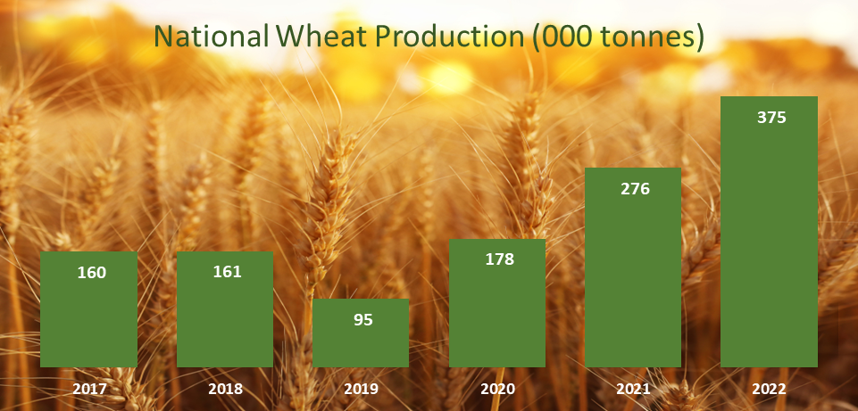
Record-High Wheat Production
Wheat production has benefited from the “Winter Wheat” scheme - a collaboration between the government and private sector that has mobilized financing for local wheat production.
As a result, wheat harvest has been systematically increasing from 95 000 tonnes in 2019 to over 400,000 tonnes projected this year.

Slide 14
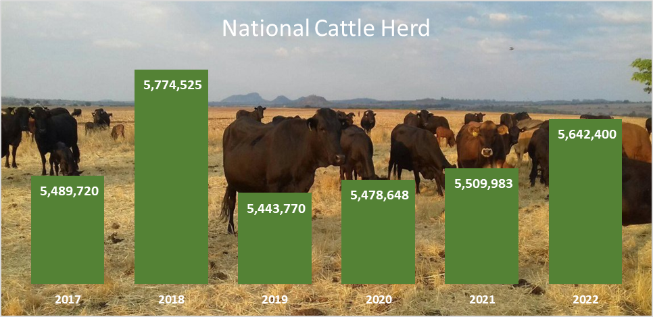
National Cattle Herd Recovery
Resources have been made available to capacitate livestock farmers, with US$200 million earmarked for beef and dairy production under the TSP.
Since suffering a sharp disease induced decline in 2019, the National cattle herd has steadily recovered, averaging 1.2% growth per annum since 2020.
The recovery has also been supported by Government programs aimed at improving animal health management and diseases control.

Slide 15
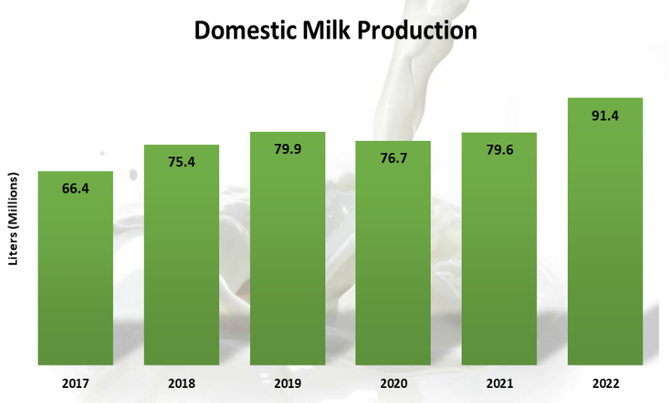
Rising Domestic Milk Production
Government led initiatives to support the small-scale dairy producers and private investment have yielded steady growth in domestic milk output.

Slide 16
Rising Domestic Milk Production
The contribution of the mining sector in the economy has been steadily increasing from 11.5% of GDP in 2018 to current levels of 13.2%.
Similarly, the sector has been on growth trajectory since 2020.
The growth is driven by increased output across all minerals and discovery of new minerals, (lithium), as well as investments in additional capacities.
(%)

Slide 17
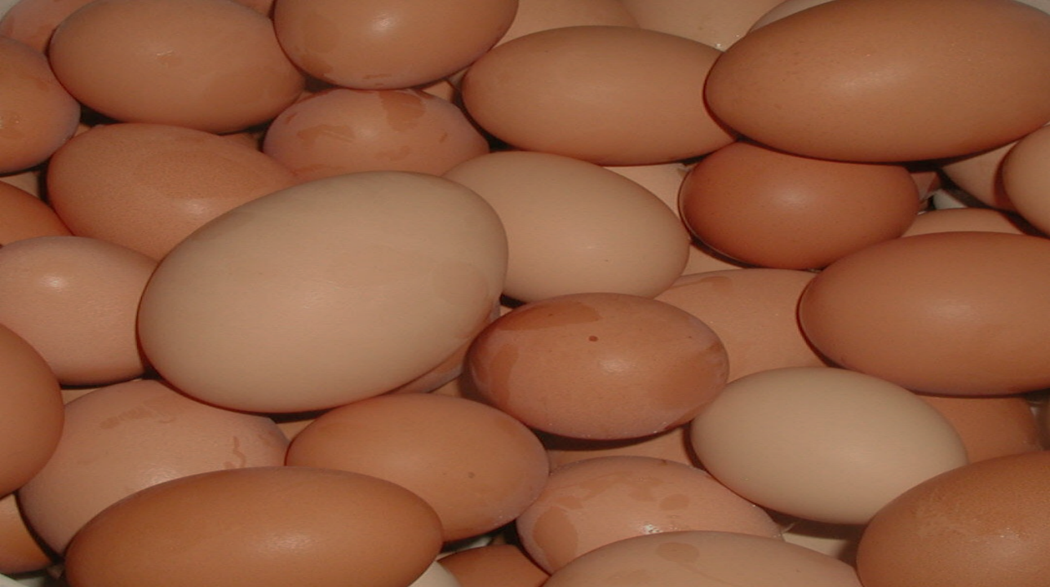

Slide 18
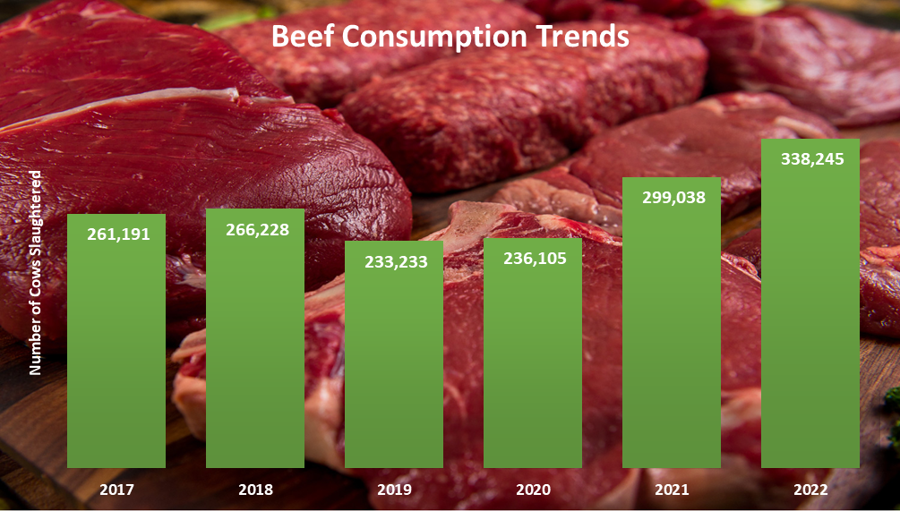

Slide 19
Mining Sector
The contribution of the mining sector in the economy has been steadily increasing from 11.5% of GDP in 2018 to current levels of 13.2%.
Similarly, the sector has been on growth trajectory since 2020.
The growth is driven by increased output across all minerals and discovery of new minerals, (lithium), as well as investments in additional capacities.
In terms of investments, the mining industry has surpassed the US$12 billion industry.
(%)

Slide 20
Mining Output
Mineral | 2017 | 2018 | 2019 | 2020 | 2021 | 2022 | 2023 | 7 Year Change
Gold/kg | 26,495 | 35,054 | 29,429 | 29,223 | 31,477 | 37,265 | 36,000 | 36%
Lithium/ (000)t | - | - | 63 | 21 | 30 | 102 | 882 | 1300%
Black Granite/(000)t | 177 | 213 | 155 | 645 | 50 | 392 | 420 | 137%
Chrome/(000)t | 1,674 | 1,756 | 1,550 | 1,272 | 1,244 | 1,154 | 1,500 | -10%
Coal/(000)t | 3,074 | 3,348 | 2,730 | 2,751 | 3,246 | 4,043 | 4,353 | 42%
Copper/(000)t | 8,839 | 9,077 | 8,678 | 7,933 | 8,650 | 10,168 | 10,473 | 18%
Diamonds/(000)t | 2,508 | 3,252 | 2,119 | 2,670 | 4,224 | 4,865 | 5,500 | 119%
Nickel/t | 16,617 | 17,850 | 16,278 | 16,336 | 13,949 | 14,260 | 14,300 | -14%
Palladium/kg | 11,822 | 12,094 | 11,640 | 12,890 | 12,619 | 13,935 | 14,214 | 20%

Slide 21
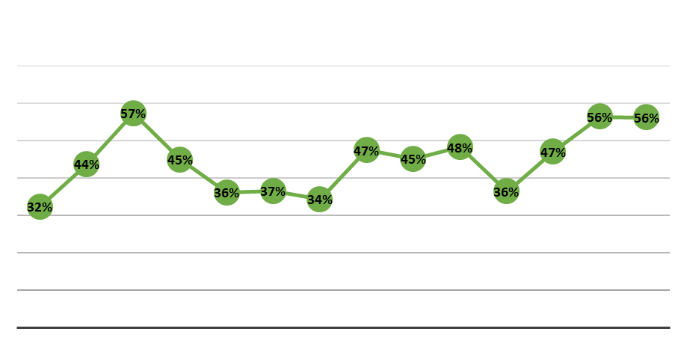
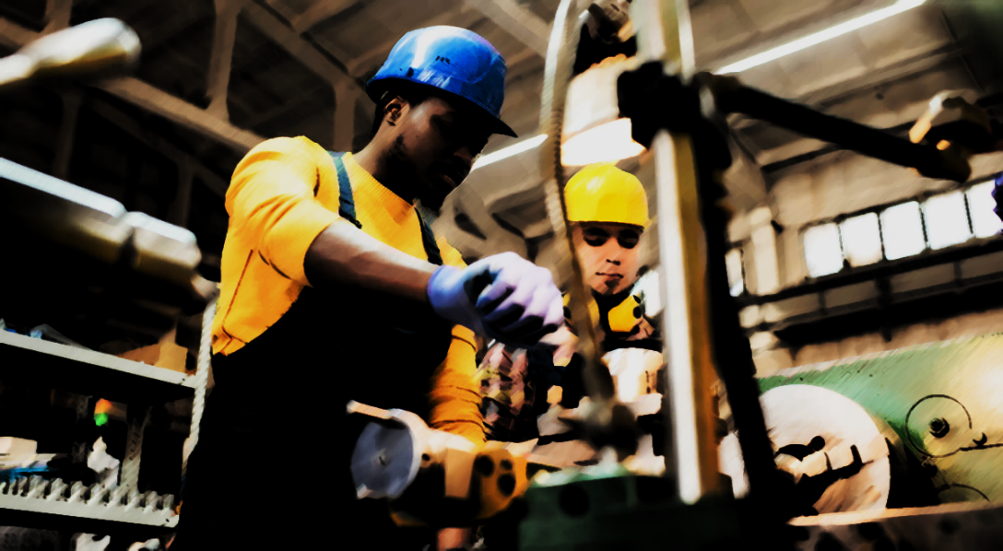
Manufacturing
Steady increases in industry capacity utilization correspond with increasing local production.
Industry capacity utilization has been at 10 year highs in 2021 and 2022.

Slide 22
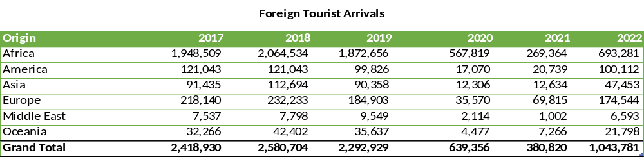
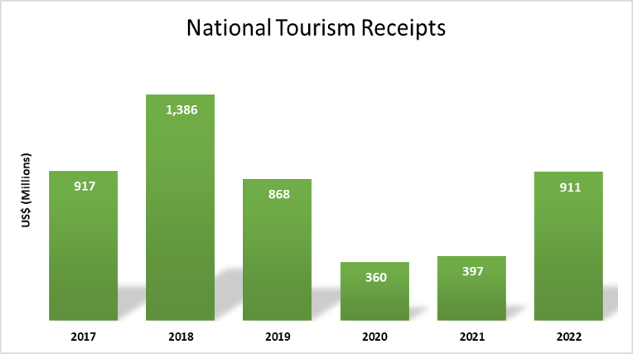
Tourism Recovery
Tourism sector is a key source of foreign currency revenues for the economy.
Government established a Tourism Revolving Fund to provide capital resources for tourism development and has made efforts to rebrand the country.
In line with the overall trend, tourist arrivals tailed off in the aftermath of the COVID-19 pandemic, but have been on the rebound since 2021.

Slide 23
Tourism Recovery
Year | Total number of Airlines | Number of Airlines which pulled out | Number of new Airlines | Total Airlines
2015 | 14 | 1 | 0 | 13
2016 | 13 | - | 2 | 15
2017 | 15 | - | 1 | 16
2018 | 16 | - | - | 16
2019 | 16 | 1 | 1 | 16
2020 | 3 | 13 (COVID -19 Pandemic) | - | 3
2021 | 3 | - | 7 | 10
2022 | 10 | - | 6 | 16
2023 | 16 | - | 1 | 17

Slide 24

ICT: Internet Data Usage
Internet and data traffic and subscriptions have consistently grown and become an integral part of the economy.
The growth is indicative of Zimbabwe’s rapid adaptation to the “Digital Age”, as the internet has become an essential tool in day to day life and commerce.

Slide 25
Inflation Developments and Outlook
Exchange rate depreciation induced inflation experienced in May and June is now under control in response to a raft of measures implemented by Government and the Central Bank.
Year-on-Year inflation decelerated to 18.4% in September from 30.9% in June 2023.
Month-on-Month inflation registering a deceleration to 0.95% in September from 12.1% in June 2023.
In the outlook, we expect inflation to continue to decelerate.

Slide 26
Exchange Rate
The exchange rate and price have stabilized in response to policy interventions made in May and June.
The stability is also attributed to the introduction of the Gold coins and Gold-backed Digital Token (ZiG) for value preservation purposes and are now for transaction purposes as well.

Slide 27
Monetary Developments
Broad money, increased from ZWL$2.3 trillion in December 2022 to ZWL$13 trillion in July 2023.
The growth reflected expansions of 639.3% and 157.4% in foreign currency deposits and local currency component respectively.
The growth in the foreign currency component was due to in increase in US dollar value of FCAs as well as exchange rate depreciation.
Credit to the private sector growth increased, a positive development towards a private led economic growth.

Slide 28
Imports
The economic growth being experienced has resulted in increased demand for imports of key raw materials, fuel and other consumables used in production.
Imports have increased from US$5.4 billion in 2019 to US$9.6 billion in 2022.
To year end, imports are expected to increase to US$10 billion.
In the outlook, imports are projected to increase to US$10.6 billion in 2024 on account of higher grain, fuel, electricity, raw materials and machinery imports.

Slide 29
Exports
Growth of the economy has resulted in the increase in the country’s export capacity, which grew from US$5.2 billion in 2018 to US$7.5 billion in 2022 mainly driven by key minerals such as gold and PGMs.
This year, due to the negative developments in the global economy, prices for most mineral commodities have been declining, negatively affecting export receipts in the economy.
As a result, export receipts, fell by 9% over the nine months to September 2023, from US$4.5 billion during the comparable period in 2022 to US$3.6 billion.
To year end, exports are however projected to grow to US$7.8 billion.
In the outlook, exports are projected to grow by 3% to US$8 billion in 2024.

Slide 30
Current Account
Since 2019, the economy has been recording current account surpluses.
Current account surplus is envisaged to close the year 2023 at US$248.5 million, slightly lower compared to US$305 million that the country registered in 2022.
Surpluses, are healthy for the economy for liquidity required to meet import requirements, currency stability and transaction purposes (multicurrency).
Current Account (US$ millions)

Slide 31
Comparative Export Receipt Earnings
Country | GDP IMF Proj (US$ B) | 2023 GDP Growth Rate (%) | Value of Exports (US$ B)
Botswana | 21.1 | 3.8 | 7.5
Malawi | 13.2 | 1.6 | 1.0
Mozambique | 18.7 | 2.3 | 2.0
Rwanda | 14.4 | 6.2 | 1.6
Zambia | 30.6 | 3.6 | 10.1
Zimbabwe | 32.4 | 5.5 | 8.0
The country is doing relatively well in terms of export receipts as compared to comparable countries in the region.

Slide 32
Revenue Performance
Government revenues in USD have increased substantially from US$2 billion in 2018 to current levels of around US$7 billion.
This is a testimony that the economy is indeed growing and more resources are being channeled towards addressing the needs of citizens.

Slide 33
Expenditure Performance
Similarly, Government capacity to spend has increased from US$3 billion in 2018 to US$7 billion.
This has enabled Government to spend on social protection and infrastructure programmes.

Slide 34
Public Finance Perf : Jan – Sept 2023
Revenue performance during the first nine months of the year performed above target on account of exchange rate and inflation movements.
Similarly, expenditures by MDAs were also way above target for the same reasons.
However, expenditures by MDAs were within the available resource envelop.
Hence, Government is still exercising fiscal discipline.

Slide 35
Public Finance Performance (Jan-Sept 2023)
Revenue collections for the period January to September 2023 stood at ZWL$11.5 trillion (approx. US$4.1 billion), against expenditures of ZWL$12.6 trillion (approx. US$4.5 billion), resulted in a budget deficit of ZWL$1.13 trillion
 | ZWL$B
Total Revenues | 11,513.0
Tax Revenues | 11,224.8
Non-Tax Revenues | 288.2
Total Expenditures & Net Lending | 12,648.6
Recurrent Expenditure | 9,373.6
Transfers to Provincial Councils and Local Authorities | 140.7
Capital | 2,611.0
Deficit | -1,135.5

Slide 36
Revenue Performance: Jan to Sept 2023
Cumulative revenue collections for the period January to September 2023 amounted to ZWL$11.5 trillion, comprised of tax revenue of ZWL$11.2 trillion (97.5% of total revenue), and non-tax revenue of ZW$288.2 billion (2.5% of total revenue).
 | ZWL$T
Total Revenue | 11.5
Tax Revenue | 11.2
Non-tax | 0.3

Slide 37
Revenue Head Performance (Jan-Sept)
37

Slide 38
Expenditure Performance (Jan-Sept)
During the period January to September 2023 cumulative expenditure amounted to ZWL$12.6 trillion.
Cumulative capital expenditure for the period Jan to August 2023 amounted to ZWL$3.3 trillion.
 | ZWL$B
Total Expenditures & Net Lending | 12,648.6
Recurrent Expenditure | 9,373.6
Compensation of Employees | 4,420.3
Use of Goods and Services | 4,453.8
Social Benefits | 171.0
Subsidies | 88.1
Interest | 51.8
Other expenses | 47.9
Transfers to Provincial Councils and Local Authorities | 140.7
Capital Expenditure | 3,275.0

Slide 39
Expenditure Distribution: Jan – Sept 2023

Slide 40
Cumulative Disbursements to MDAs: Jan to Sept 2023: (ZW$B)
Vote Appropriations | Original Estimate | Revised Estimate | Expenditures to Sept | Budget Performance
Office of the President and Cabinet | 161.7 | 173.1 | 760.4 | 439%
Parliament of Zimbabwe | 49.3 | 49.3 | 64.1 | 130%
Public Service, Labour and Social Welfare | 92.6 | 92.6 | 158.9 | 172%
Defence and War Veterans | 331.1 | 331.1 | 2314.4 | 699%
Finance and Economic Development | 254.7 | 191.6 | 574.1 | 300%
Audit Office | 10.4 | 10.4 | 10.0 | 96%
Industry and Commerce | 15.6 | 15.6 | 15.3 | 98%
Lands, Agriculture,Water, Climate and Rural Resettlement | 362.5 | 395.7 | 1645.5 | 416%
Mines & Mining Development | 13.0 | 13.0 | 20.0 | 154%
Environment, Tourism and Hospitality Industry | 14.2 | 14.2 | 37.6 | 265%
Transport and Infrastructural Development | 144.6 | 144.6 | 646.1 | 447%
Foreign Affairs and International Trade | 81.9 | 81.9 | 177.8 | 217%
Local Government and Public Works | 98.6 | 98.6 | 247.4 | 251%
Health and Child Care | 473.8 | 478.0 | 704.4 | 147%
Primary and Secondary Education | 631.3 | 631.3 | 1218.2 | 193%
Higher & Tertiary Education, Science and Technology Development | 156.5 | 156.5 | 309.5 | 198%
Women Affairs, Community, Small and Medium Enterprises Development | 18.5 | 18.5 | 34.7 | 187%
Home Affairs and Cultural Heritage | 293.0 | 294.8 | 672.9 | 228%
Justice, Legal and Parliamentary Affairs | 120.8 | 120.8 | 195.6 | 162%
Information, Publicity and Broadcasting Services | 10.1 | 10.1 | 46.9 | 464%

Slide 41
Cumulative Disbursements to MDAs: Jan to Sept 2023: (ZW$B)
Vote Appropriations | Original Estimate | Revised Estimate | Expenditures to Sept | Budget Performance
Youth, Sport, Arts and Recreation | 27.7 | 37.9 | 195.6 | 517%
Energy and Power Development | 37.9 | 37.9 | 65.9 | 174%
Information Communication Technology and Courier Services | 79.5 | 79.5 | 177.2 | 223%
National Housing and Social Amenities | 4.2 | 4.2 | 34.9 | 840%
Judicial Services Commission | 4.7 | 4.7 | 7.6 | 160%
Public Service Commission | 3.0 | 3.0 | 6.5 | 221%
Council of Chiefs | 11.3 | 11.3 | 17.2 | 152%
Human Rights Commission | 7.4 | 7.4 | 8.4 | 114%
National Peace and Reconciliation Commission | 101.6 | 102.3 | 632.8 | 618%
National Prosecuting Authority | 3.5 | 3.5 | 3.6 | 104%
Zimbabwe Anti-Corruption Commission | 10.4 | 10.4 | 12.0 | 115%
Zimbabwe Electoral Commission | 2.6 | 2.6 | 9.2 | 352%
Zimbabwe Gender Commission | 3,686 | 3,686 | 11,135 | 302%
Zimbabwe Land Commission | 27.7 | 37.9 | 195.6 | 517%
Zimbabwe Media Commission | 37.9 | 37.9 | 65.9 | 174%
TOTAL | 79.5 | 79.5 | 177.2 | 223%
Debt Service: Interest Bill | 25.0 | 25.0 | 51.8 | 25.0
Pension | 277.5 | 277.5 | 549.1 | 277.5
Public Service Pension Scheme | 27.9 | 27.9 | 37.4 | 27.9
Transfers to Provincial Councils and Local Authorities | 195.5 | 195.5 | 112.2 | 195.5
Other Constitutional & Statutory Appropriations | 34.7 | 34.7 | 329.0 | 34.7
Total Expenditure & Net Lending | 560.6 | 560.6 | 1079.6 | 560.6
Repayment of Loans | 248.6 | 248.6 | 103.4 | 248.6
Total Expenditure & Net Lending Including Loan Repayments | 809.2 | 809.2 | 1183.1 | 809.2

Slide 42
Value for Money in Public Spending
Since August 2022, Government is making substantial savings, approximately 30%, through implementation of value for money on procurement of public goods and services.
This is being achieved through the review of the procurement processes, including requirement to exercise due diligence to avoid paying for overpriced products.
Government is currently working on strengthening the Public Procurement Act, and relevant regulations, including the introduction of the e-procurement system.
Already, the Government has set standardization of prices of goods supplied to all Government Departments.

Slide 43
Public Debt
Total public debt is estimated as at US$18 billion as at 31 December 2022.
    External debt is at US$12 billion.
    Domestic debt at US$5 billion.
Arrears are about US$6.6 billion.
This debt overhang is constraining the country to access reasonable cost of capital critical for financing infrastructure projects.
To address this, Government is implementing an Arrears Clearance, Debt Relief and Restructuring Strategy.
Already, Government has established a Structured Dialogue Platform with all creditors with a view to resolve the debt overhang situation.
 | US$M
Total PPG Debt (1+2) (External + Domestic) | 18,028
1. External Debt (a+b+c) (including RBZ debt) | 12,827
External Debt (a+b) (excluding RBZ debt) | 8,586
a.Bilateral Creditors | 5,890
Paris Club | 3,761
Non-Paris Club | 2,128
b.Multilateral Creditors | 2,697
World Bank | 1,546
African Development Bank | 692
European Investment Bank | 395
Others | 64
c.RBZ Debt | 4,241
2. Domestic Debt | 5,201
Treasury Bills/Bonds | 188
Blocked Funds | 1,501
Arrears to service providers | 12
Compensation of Former Farm Owners | 3,500

Slide 44
Update on Infrastructure Projects

Slide 45
Update on Infrastructure Development
As part of Government’s commitment to improve the living conditions of the general populace and improve the ease of doing business, massive infrastructure development is underway across the country with completion of projects being realised in some critical sectors.

Slide 46
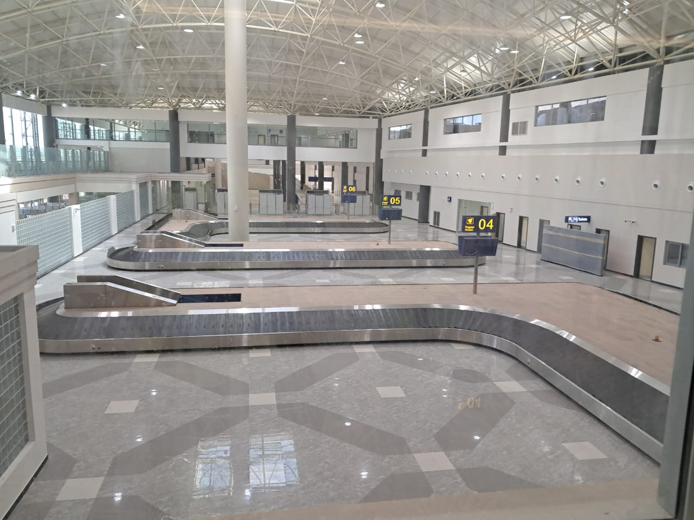
Airports
Cumulative disbursement of US$108.8 million, has been made so far towards R.G. Mugabe International Airport Expansion Project, which was commissioned in July 2023.
During the first quarter of 2023, Government completed the refurbishment of the Binga Airstrip which ignited a tourism boom in the remote district as evidenced by increased number of international tourist arrivals.
The refurbishment of airports is attracting more airlines into the country, resulting in a positive impact on the demand for accommodation and driving growth of the sector.

Slide 47
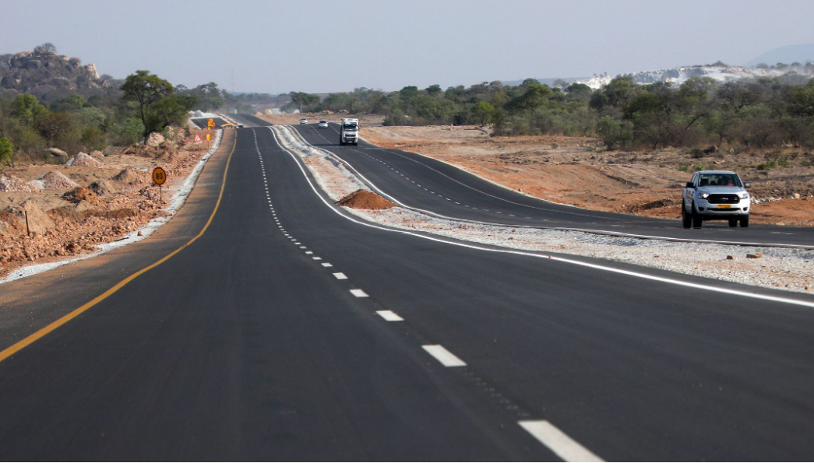
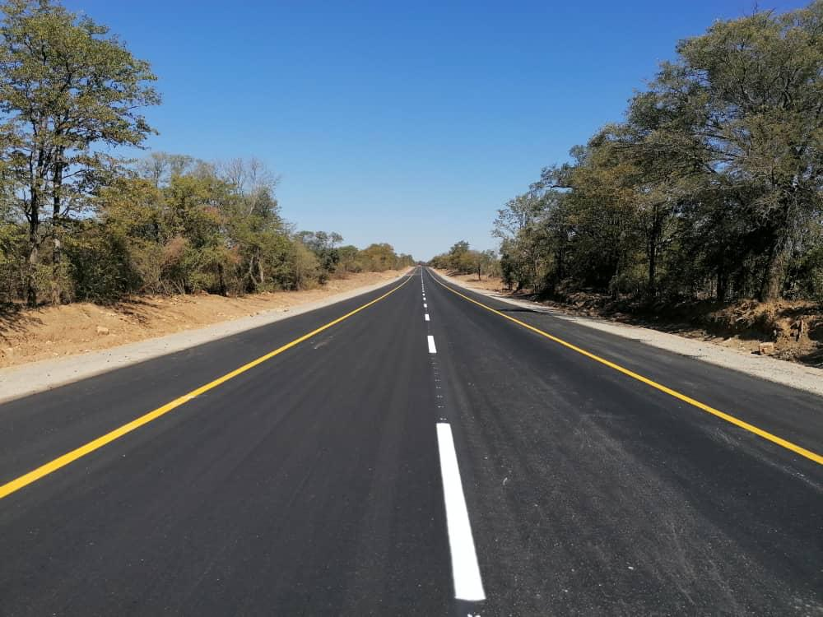
Ports of Entry and Road Rehabilitation
Roads improve inter-city connectivity.
A total of 450 km has been opened to traffic for the Harare-Masvingo-Beitbridge road and the remaining 129 km are expected to be completed by year end.
Various road projects under the Emergency Rehabilitation Road Programme are underway.
Beitbridge boarder post completed at a cost of US$300 million.
Government has started the refurbishment of three major ports of entry and highways that connect Zimbabwe to the region (Kazungula One Stop Border Post, Forbes Border Post and Nyamapanda border post and road project).
Ease of movement of goods and travellers through ports of entry contribute significantly to tourism and economic growth.

Slide 48
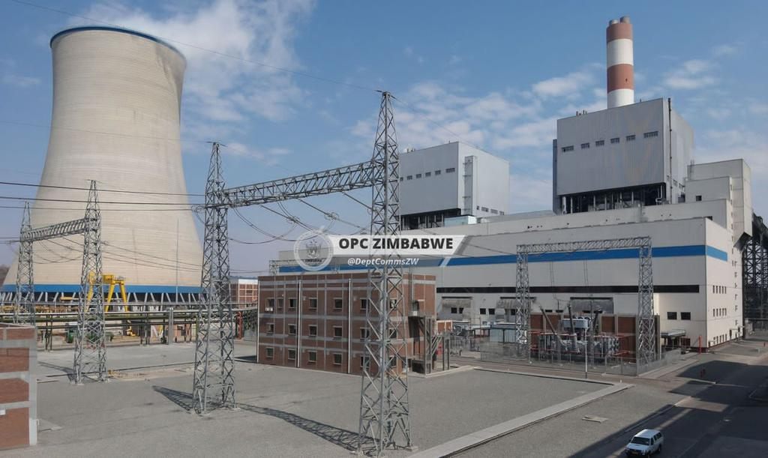
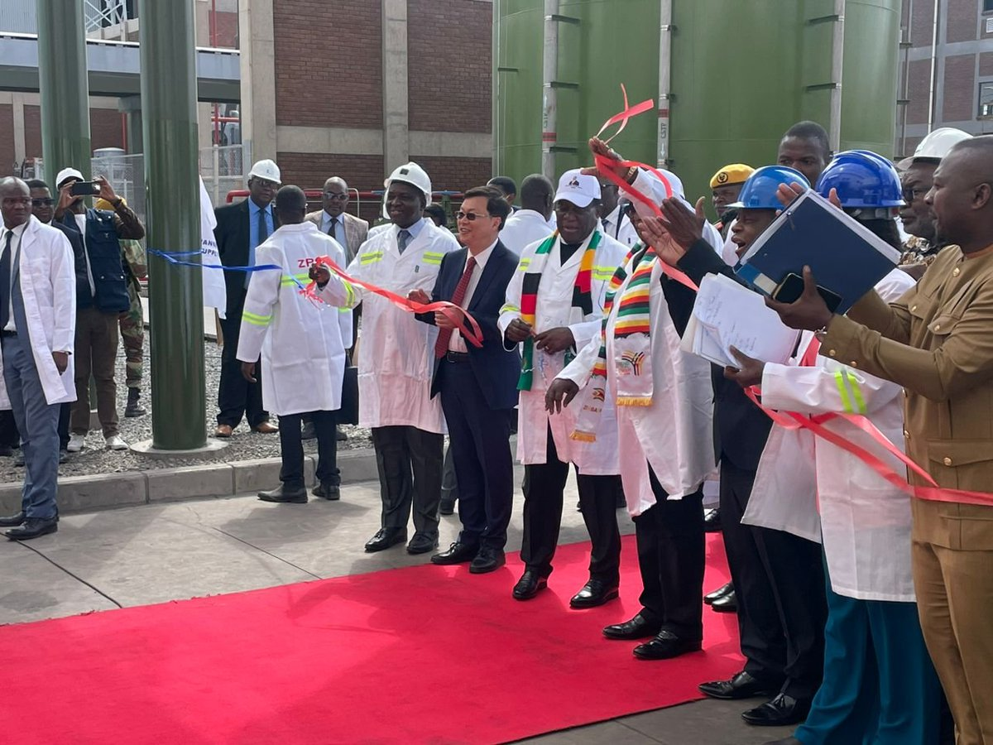
Energy
The key flagship project in the energy sector is the Hwange 7 & 8 extension project with a generation capacity of 600 MW and being funded through a loan facility from China Exim Bank.
Both units 7 & 8 have been successfully synchronized and connected to the grid during the second quarter of 2023.
Subsequently commissioned on 3 August 2023 by the H. E, President E. D. Mnangagwa

Slide 49
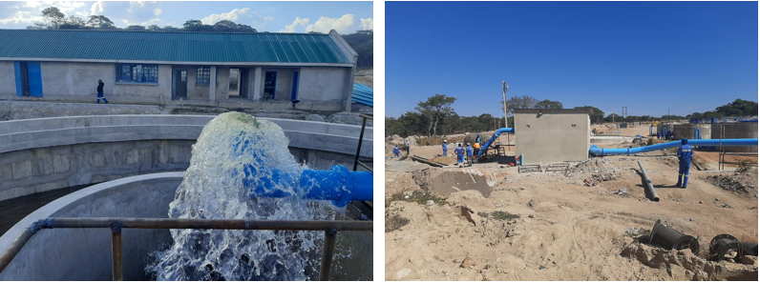
Water and Sanitation
Borehole drilling and rehabilitation is underway through the Rural Development Programme.
Since 2018, Government has drilled 4 802 and rehabilitated 39 001 boreholes.
Dam construction is also underway with Chivhu dam having been commissioned in 2023.
The construction of Gwayi-Shangani dam is now at 70.2%, with 39m of the dam wall having been completed out of the targeted 72m.
Completion of the dam and the complementary Gwayi-Shangani pipeline is expected to be achieved by end of 2024.
Chivu water supply treatment plant Water supply works

Slide 50
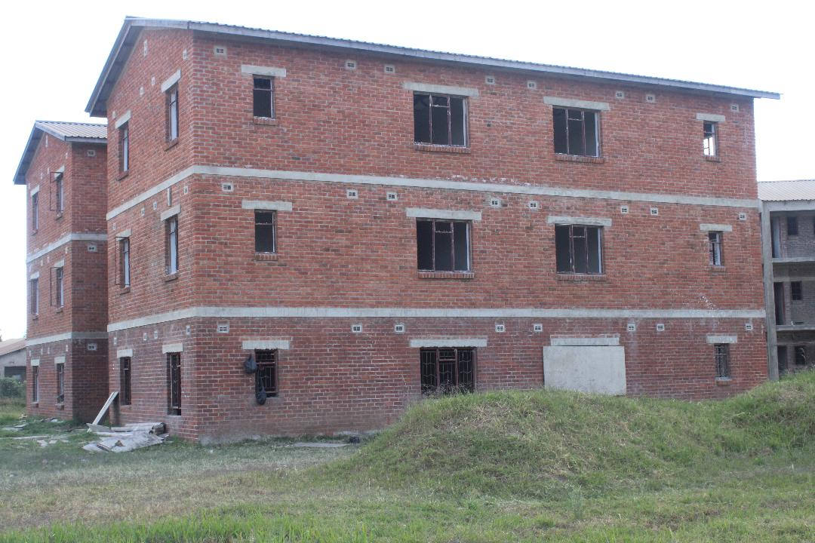
Housing Development
Dzivarasekwa Flats
Housing development for both residential and institutional accommodation is underway.
Key projects that were completed include Lupane Civil Servants houses, Binga houses and Beitbridge flats.
On-going works in Marondera, Dzivarasekwa and Senga are focused on residential flats, as well as servicing of stands.
The number of housing units completed and fully serviced as of end May 2023 stood at 49 150 and 136 850, respectively, giving a total delivery of 186 000 housing units across all provinces

Slide 51
NDS1 REVIEW

Slide 52


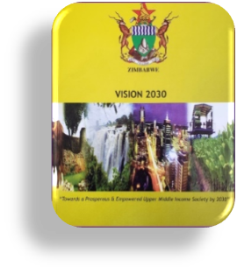
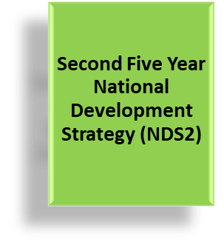
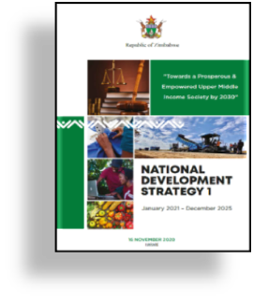
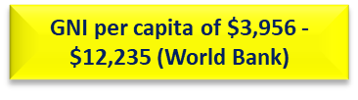
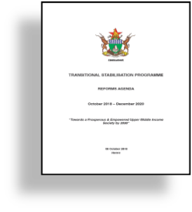
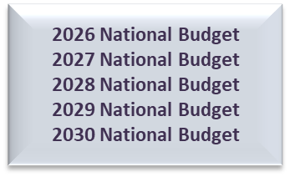
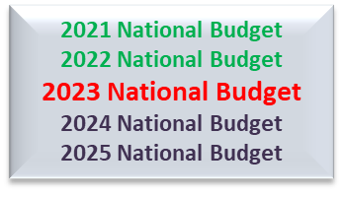
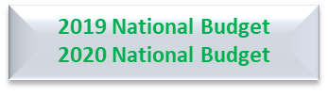
Journey Towards Vision 2030……
l

Slide 53
NDS1 MID-TERM REVIEW
The year 2023 marks the mid-point in the implementation of National Development Strategy 1 (NDS 1), the second of three successive National Development Plans towards the realisation of the aspirations of Zimbabwe’s National Vision for a Prosperous and Empowered Upper Middle-Income Society by 2030.
The country undertook the Mid-Term Review of the National Development Strategy 1 over March – June 2023, to evaluate performance with implementation during 2021 to mid-year 2023.
The review offers opportunity for stock taking of highlights of progress and identification of gaps, that way indicating areas for remedial action for the full realisation of NDS 1 objectives during the remainder of implementing the Strategy.

Slide 54
Summary of the Review Findings
Pillar | Progress
1. Economic Growth and Stability | The economy exhibited high performance, with real GDP growth of 8.5% in 2021, 6.5% in 2022 and 6.2% in the first quarter of 2023, anchored on agriculture and mining sectors.
2. Food and Nutrition Security | Overall maize output go up from 907 629 tonnes in 2020 to 2.7 million tonnes in 2021, well in excess of NDS 1 targeted levels of 1.8 million tons Zimbabwe achieved wheat self-sufficiency during the first half of NDS1, with record breaking wheat production of 337 212 tons and 375 131 tons in the 2021 and 2022 winter seasons, respectively.
3. Moving the Economy up the Value Chain and Structural Transformation | The manufacturing sector’s capacity utilisation increased from 36.4% registered in 2020 to 66% in 2022 Which saw the increase in domestically produced goods in supermarket shelves, accounting for about 80%. Earnings from beneficiated minerals increased from US$1.157 billion in 2020 to US$4.6 billion in 2022, with contributions from gold and platinum group of metals, each accounting for US$2 billion followed by high carbon ferro-chrome registering US$347.6 million; coking coal, US$130.7 million; and diamonds, US$121.7 million.

Slide 55
Summary of the Review Findings
Pillar | Progress
4. Infrastructure and Utility | A number of infrastructure projects were implemented including: Road development programmes, notably the Harare-Masvingo-Beitbridge high way, and road rehabilitation works across both rural and urban areas, under the Emergency Road Rehabilitation Program (ERRP). Dam construction projects, notably Marovanyati, Muchekeranwa, Chivhu, Gwayi-Shangani, Kunzvi, among others. Construction and rehabilitation of such public amenities as recreational facilities in schools and information communication technologies (ICT) kiosks in both urban and rural areas. Construction and rehabilitation of schools, hospitals and clinics through Devolution inter-governmental fiscal transfers. 600 megawatts were added onto the national grid during the first half of NDS 1, as Hwange 7 & 8 came on-stream mid-2023.
5. Digital Economy | Internet penetration rate exceeded the projected target of 62.06% to reach 63.1% in 2021 and increased to 65.3% in 2022. Significant progress was made by both Government and the private sector to enhance use of ICTs through deployment of backbone infrastructure, installation of broadband base stations, as well as laying of fibre optic infrastructure.
6. Housing Delivery | A a total of 186 000 housing units were fully serviced and completed across all provinces 96% of the urban population and 64% of rural population had access to basic water services, while 51.1% of the urban population and 54% of the rural population had access to basic sanitation services.

Slide 56
Summary of the Review Findings
Pillar | Progress
7. Governance | 1 873 court cases were cleared due to the introduction of the integrated electronic case management system which assisted in clearing a backlog of cases.
8. Social Protection | 3 million and 3.2 million households benefited from food assistance in 2021 and 2022, respectively. 3 218 267 children were assisted through the Basic Education Assistance Module (BEAM)
9. Image Building, International and Engagement Re-Engagement | 14 million social media impressions were realised, against a target of 8 million. 13 re-engagement meetings were held in against a target of 6
10. Environmental Protection, Climate Resilience and Natural Resources Management | five (5) weather radars for monitoring and supporting disaster preparedness for citizens were procured, of which three were completed and now functional radars, while the remaining two are at 95% and 60% levels of completion. 58 320 hectares of forest area under rural district councils’ jurisdiction was protected in 2021. In 2022, 54 985 hectares were protected, against the NDS 1 target of 49 500 hectares.
11. Youth, Sport and Culture | The Chambuta Interact Centre was established in Chiredzi to enhance youth sport, arts and cultural activities. Vocational training centres (VTCs) were refurbished and re-tooled. The curriculum on vocational training was also reviewed, with 8 training modules being developed and approved by the Zimbabwe National Qualifications Framework. Generally, the proportion of the population who participated in youth, sport, arts and recreation activities increased during the first half of NDS 1.

Slide 57
Summary of the Review Findings
Pillar | Progress
12. Health and Wellbeing | Government made commendable efforts towards overall improvement in health delivery systems during the first half of the implementation of NDS 1. Government introduced a policy of buying drugs directly from local manufacturers to reduce the costs and improve drugs availability in public institutions. Locally produced essential medicines reached 46.9% in 2021, exceeding the NDS 1 set target of 35%.
13. Human Capital Development | The reconfiguration of Education 5.0, complemented by the construction of supporting education infrastructure, has increased innovative and industrialisation learning opportunities. 13 innovation hubs and industrial parks were established at tertiary institutions.
14. Devolution | Inter-governmental fiscal transfers were disbursed to local authorities. 858 projects were funded through the utilisation of inter-governmental fiscal transfers. Of these, 296 projects were completed, while 562 are at various stages of completion.

Slide 58
Preliminary 2024 Macro-Fiscal Framework

Slide 59
Fiscal Framework
In 2024, the economy is projected to grow by 3.5%, underpinned by the following assumptions:
  Normal to below normal rainfall season;
  Slowdown in global economic growth and geopolitical tensions;
  Declining international commodities prices;
  Continuation of multicurrency regime; and
  Tight fiscal and monetary policies.
The macro-fiscal framework projects revenue collections at ZWL$44.1 trillion in 2024.
To broaden the fiscal space, tax administration will be enhanced through, among others, adoption of new technology.
Expenditures are projected at ZWL$47.8 trillion, broken down as ZWL$24.7 trillion for compensation of employees and capital expenditure at ZWL$10.3 trillion.
Total bids so far amount to over ZWL$110 trillion, against a budget framework of ZWL$47 trillion.

Slide 60
Macro-Fiscal Framework: 2021-26
 | 2023 Proj. | 2024 Proj. | 2025 Proj. | 2026 Proj.
National Accounts (Real Sector)
Nominal GDP at market prices (Million ZWL$) | 119,017,891.8 | 247,259,274.40 | 358,025,718.6 | 436,600,332.5
Real GDP Growth (%) | 5.5 | 3.5 | 5.0 | 5.1
Government Accounts
Revenues (excluding Retained Revenue) | 21,186,130.9 | 44,144,356.00 | 65,217,141.2 | 79,710,202.9
% of GDP | 17.8 | 17.9 | 18.2 | 18.3
Expenditures & Net Lending (Million ZWL$) | 22,626,872.9 | 47,793,225.20 | 66,039,222.7 | 80,865,544.5
% of GDP | 19.0 | 19.3 | 18.4 | 18.5
Recurrent Expenditures | 18,905,137.4 | 39,697,514.80 | 45,767,243.4 | 53,281,196.5
% of GDP | 15.9 | 16.1 | 12.8 | 12.2
Employment Costs including Pension | 10,862,577.8 | 24,720,839.40 | 28,311,469.3 | 33,114,226.9
% of GDP | 9.1 | 10 | 7.9 | 7.6
% Total Expenditure | 48.0 | 51.7 | 42.9 | 40.9
% of Revenue | 51.3 | 56 | 43.4 | 41.5
Capital Expenditure & Net lending | 3,960,701.7 | 10,302,928.30 | 10,751,051.3 | 12,908,578.6
% of GDP | 3.3 | 4.2 | 3.0 | 3.0
Overall Balance | -1,440,742.0 | -3,648,869.20 | -822,081.5 | -1,155,341.6
% of GDP | -1.2 | -1.5 | -0.2 | -0.3

Slide 61
Risks to the Framework
Downside risks to the growth outlook include:
  El Niño induced drought;
  Declining global energy and food prices;
  Geopolitical tensions;
  Outbreaks of pandemics and endemics;
  Weak growth prospects of global economy; and
  Climate change.

Slide 62
2024 BUDGET PRIORITIES

Slide 63
2024 BUDGET PRIORITIES
2024 National Budget Theme: ‘Consolidating Economic Transformation’
Consistent with the objectives of NDS1 and the need to create a resilient and complex economy which can generate decent jobs and higher incomes, the forthcoming national budget will focus on the following priority areas:
  Economic Growth and Macro-Economic stability;
  Supporting Productive Value Chains;
  Infrastructure, ICTs and Digital Economy;
  Youth, Sport, Arts and Culture;
  Women, Gender Equity and SMEs;
  Devolution and Decentralisation
  Human Capital Development, Well-being and Innovation;
  Effective Institution Building & Governance; and
  Image building, Engagement and Re-engagement/ Arrears clearance and debt restructuring.

Slide 64
Proposed Strategic Priority Areas
Pillar | Some of the Policy Interventions
Economic Growth & Macro-Stability | Fiscal and monetary policy consolidation measures; Undertake State Enterprise reforms; Implement the National Financial Inclusion Strategy II and measures to mobilise savings Improve the requisite infrastructure and technology, regulatory environment, as well as enforce regulations to sustain financial markets development
Supporting Productive Value Chains | Identify anchor projects in each sector that will support export growth, attract investment capital and create decent jobs for citizens; and Upscale value addition and beneficiation of export products, disincentives on importation of non-essential imports and mobilise diaspora remittances
Infrastructure, ICTs & The Digital Economy | Upscale enforcement of best practices in the infrastructure space such as proper project planning, implementation, monitoring and evaluation, among others; Review the current public sector infrastructure funding; Expedite the e-Government Programme; Explore sustainable Structured Finance Arrangements with the private sector that are sustainable and affordable for infrastructure development.

Slide 65
Proposed Strategic Priority Areas Cont’d
Pillar | Some of the Policy Interventions
Youth, Sport, Arts and Culture | Prioritise and enhance citizen participation in sports, recreation, arts, culture and heritage activities through upscaling renovations of existing sporting facilities and construction of standard sports stadia; Upscale the involvement of community leaders and family systems in awareness and mitigatory measures against drug and substance abuse;
Women, Gender Equity and SMEs | Prioritise capitalization of empowerment institutions such as Zimbabwe Women’s Microfinance Bank, Empower Bank and the Small and Medium Enterprises Development Corporation (SMEDCO).
Devolution & Decentralisation | Scale up projects and programmes that transforms the lives of the people; and Finalize the devolution legal framework.

Slide 66
Proposed Strategic Priority Areas Cont’d
Pillar | Some of the Policy Interventions
Human Capital Development, Well-Being and Innovation | Prioritise improved access to quality and inclusive health and education services, technology transfer and usage; Focus on building capacity for containment of future epidemics and other health related challenges through establishment of new facilities, upgrading of existing assets and equipment; Ringfence resources towards social protection programmes such as social assistance, social care and support services, among other interventions.
Effective Institution Building & Governance | Support decentralization of public service delivery institutions.
Image Building, Engagement & Re-Engagement | Focus on implementing reforms that culminated from the Structured Dialogue Platform (SDP) meetings culminated under the following three pillars: - •Economic Reforms; •Governance Reforms; and •Land Tenure Reforms, Compensation of Former Farm Owners and the Resolution of Bilateral Investment Protection and Promotion Agreements (BIPPAs).

Slide 67
Conclusion
MDAs are encouraged to use the available resources efficiently.
Hon. Members are encouraged to make recommendations on priorities cognisant of the budget constrain as presented earlier.
Treasury is open to all recommendations that seeks to enhance the lives of the people of Zimbabwe.

Slide 68
I THANK YOU!!

